Slide 1
FT590 Week2

Slide 2
Problem 1
Conclusion: These two equations are the same thing

Slide 3
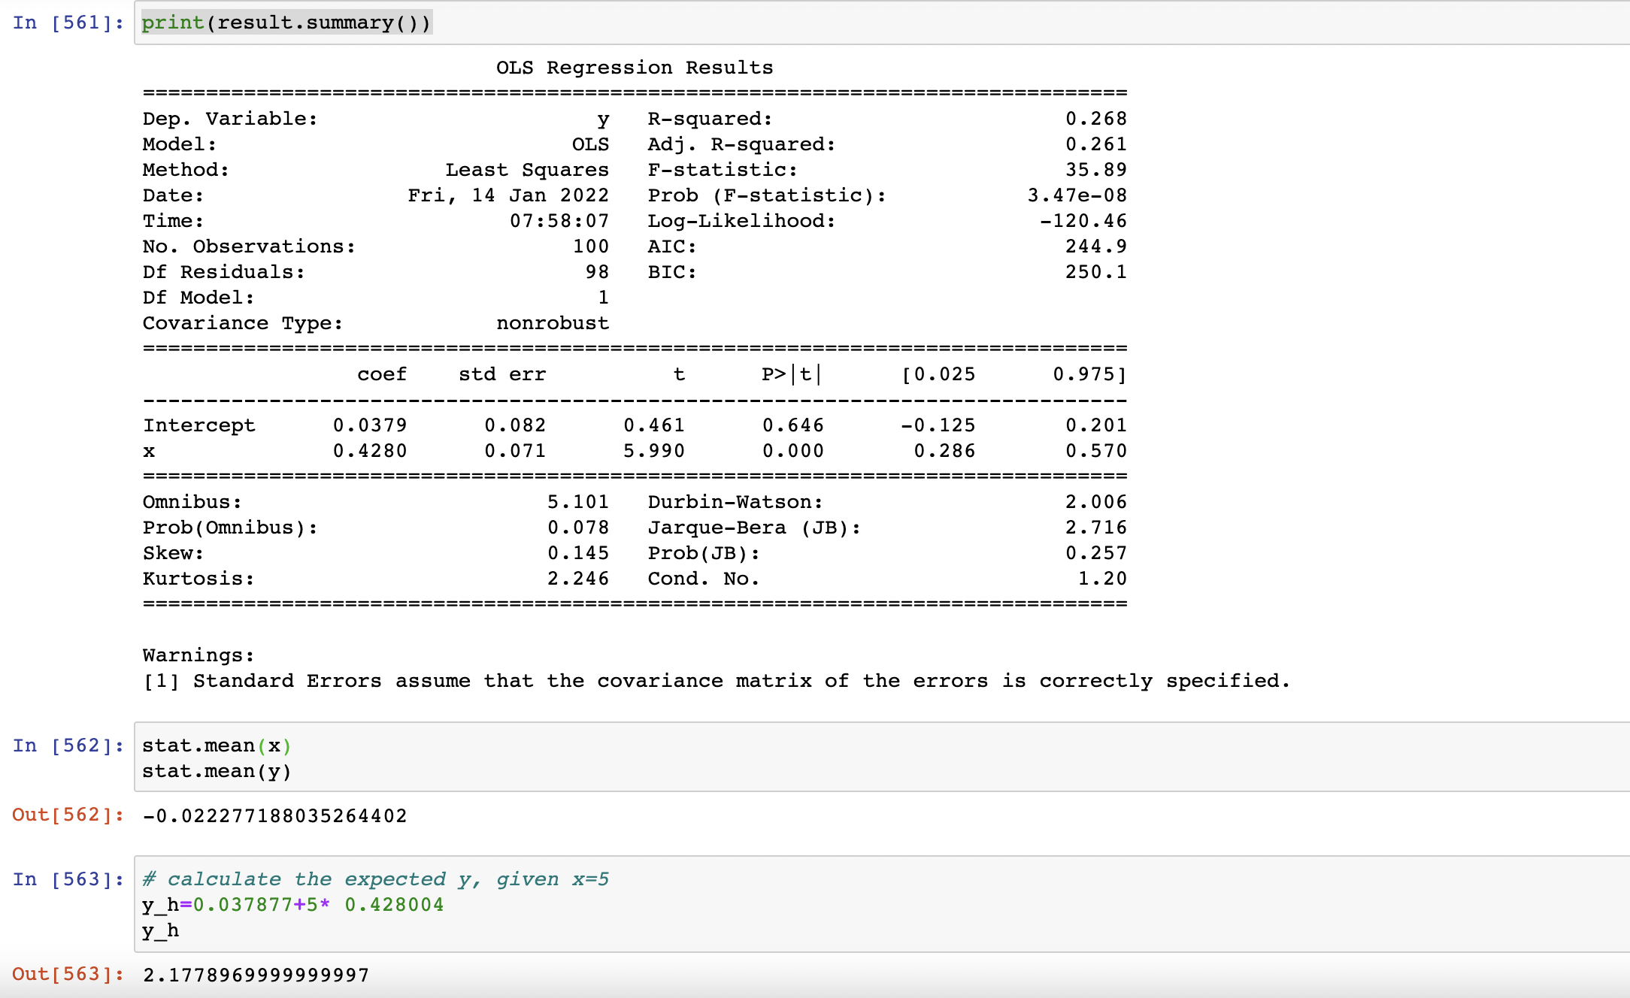

Slide 4
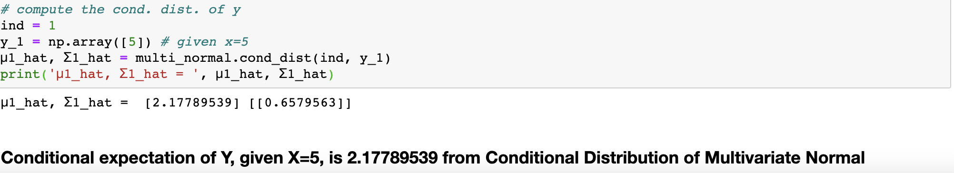

Slide 5
Problem 2
Conclusion: These two equations are the same thing

Slide 6
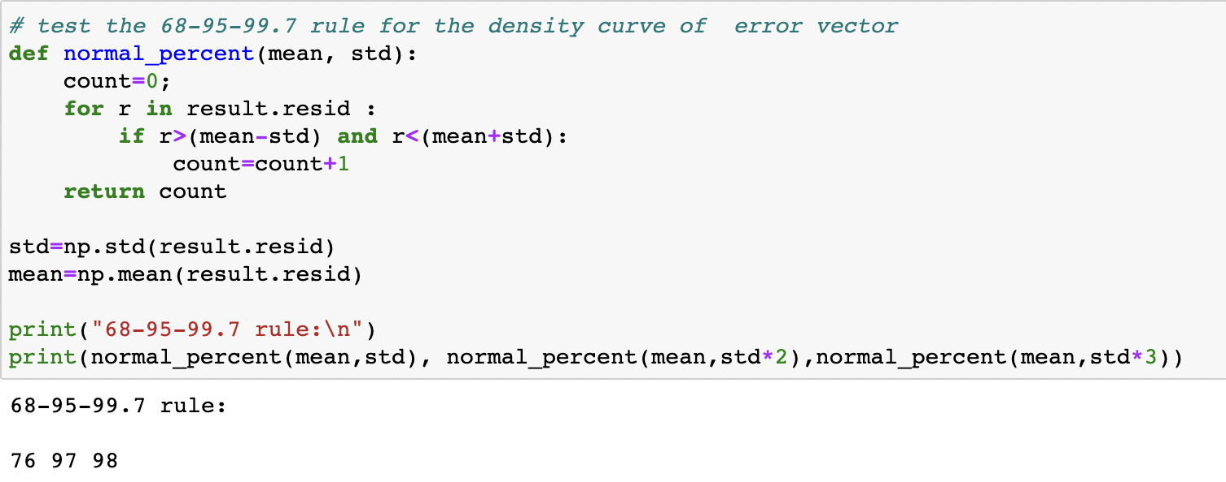
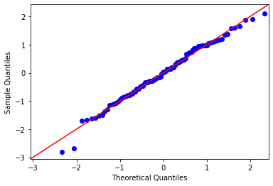
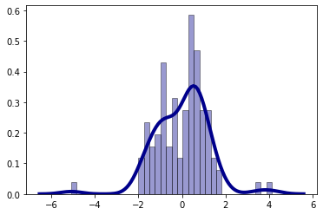

Slide 7
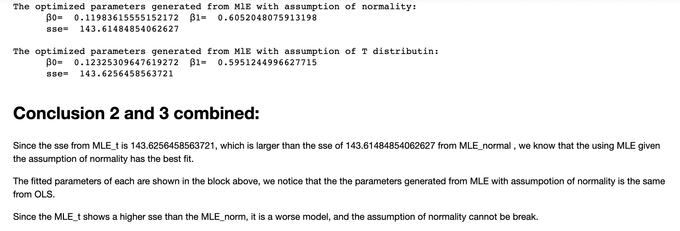

Slide 8
Problem 3
AR(1)-AR(3)

Slide 9
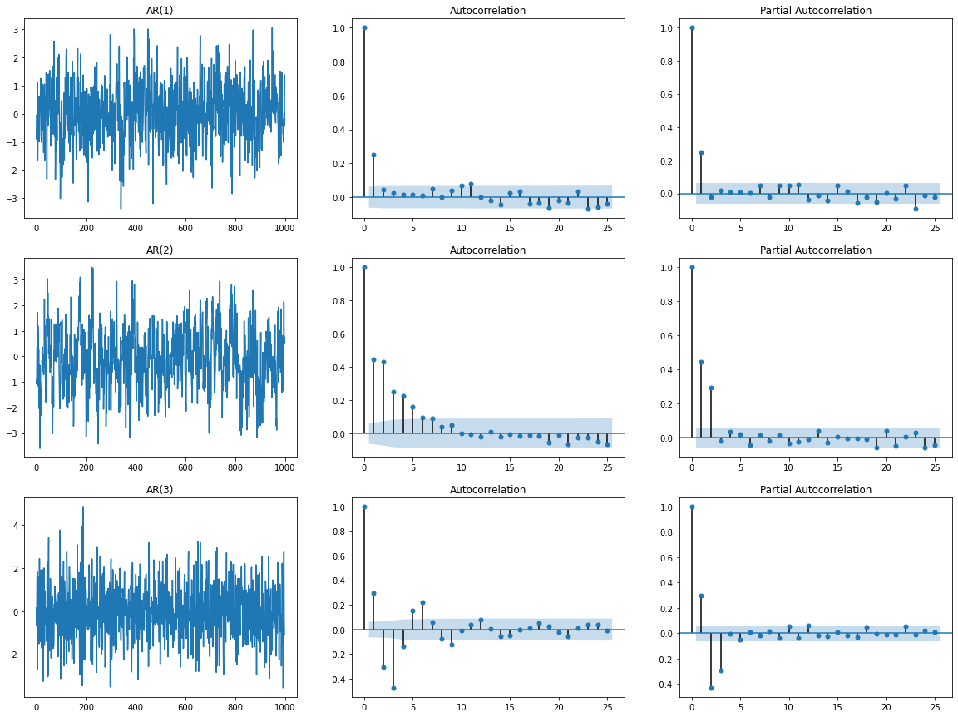

Slide 10
Problem 3
MA(1)-MA(3)

Slide 11
